Slide 1
Practice of basic bioinformatics techniques
Practical Class: Linux, R Language, and an integrative practice
http://cis.hku.hk/tutorial/OMICs_2022.html

Slide 2
Report requirements:
Save the screenshots of the questions and exercises, fill the answer sheet and email it to biol4417omics@gmail.com by May 9th.

Slide 3




Software Needed
FileZilla
R Language
Integrative Genomics Viewer

Slide 4
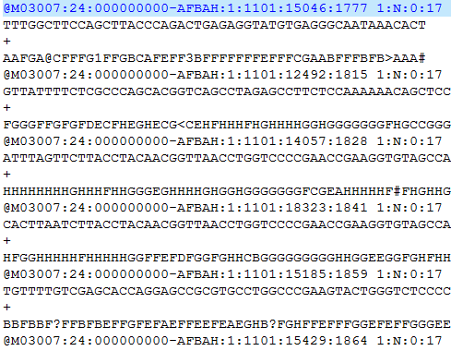
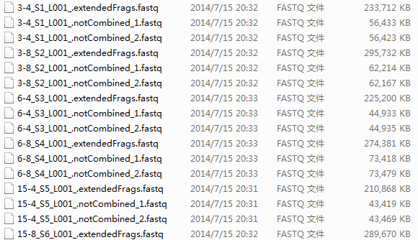
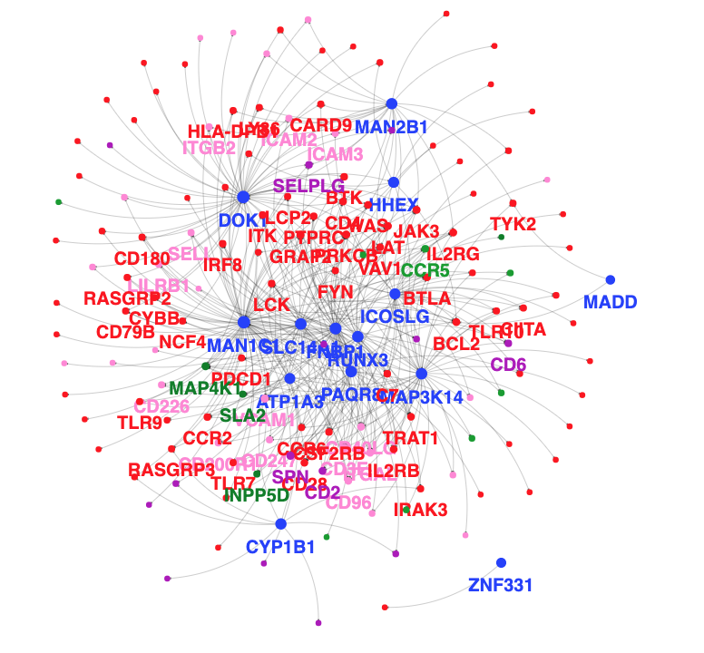
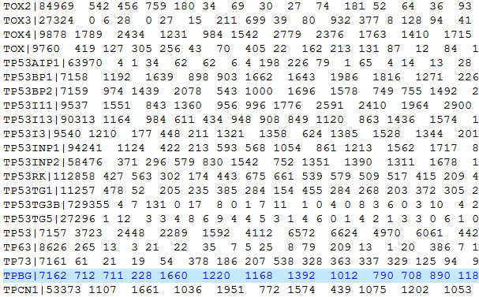
Biomedical data
One of the most basic tasks in bioinformatics is data mining, that need to store and handle big data.

Slide 5
Why Linux
Needs more processor power and more hard drive space than a typical personal computer
Computers that can provide this power generally use the Linux/UNIX operating system, which is stable and efficient
Linux comes with a lot of tools to manipulate / search / analyze raw data files.
Most of bioinformatics software is created and can only be accessed in Linux/Unix

Slide 6
Bioinformatics tools in Linux
Data layer:
Linux file system
mySQL bio-database construction
Logic layer:
Perl - programming language. Sequence analysis, motif/pattern recognition, text mining
R/Python/Matlab – Statistic language. Statistics, big data analysis, data mining, machine learning, data visualization
Applications:
Blast/Clustal –similarity search and multiple alignment
Bowtie/BWA – Sequencing data alignment
Phred/Phrap/Consed/SOUP/Picard/GATK - genome assembly and SNP detection

Slide 7
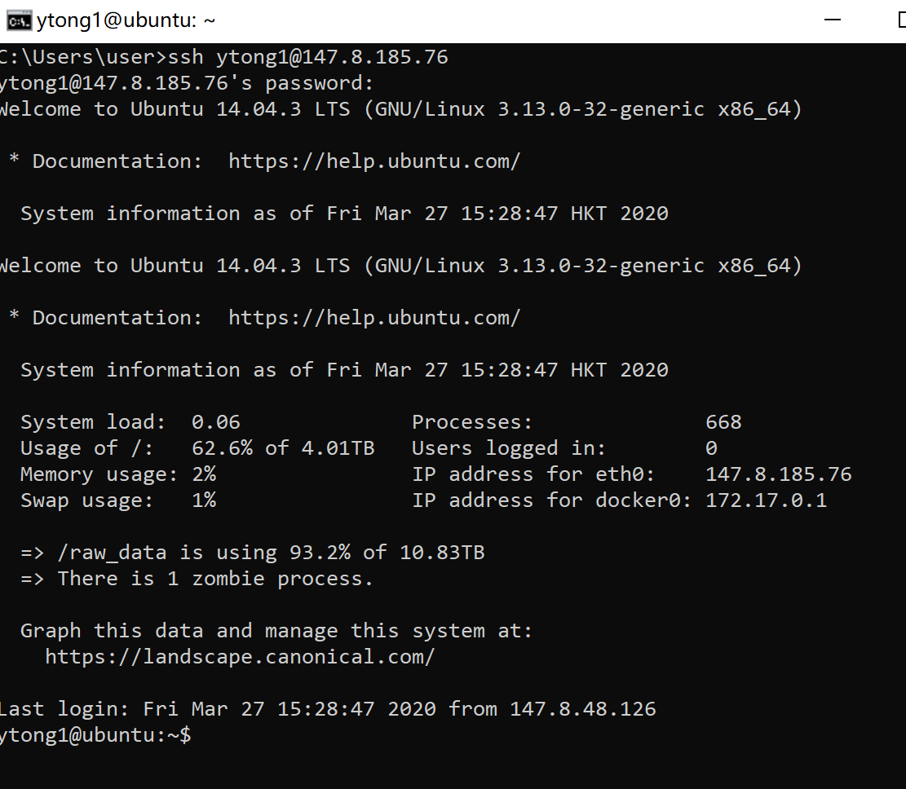
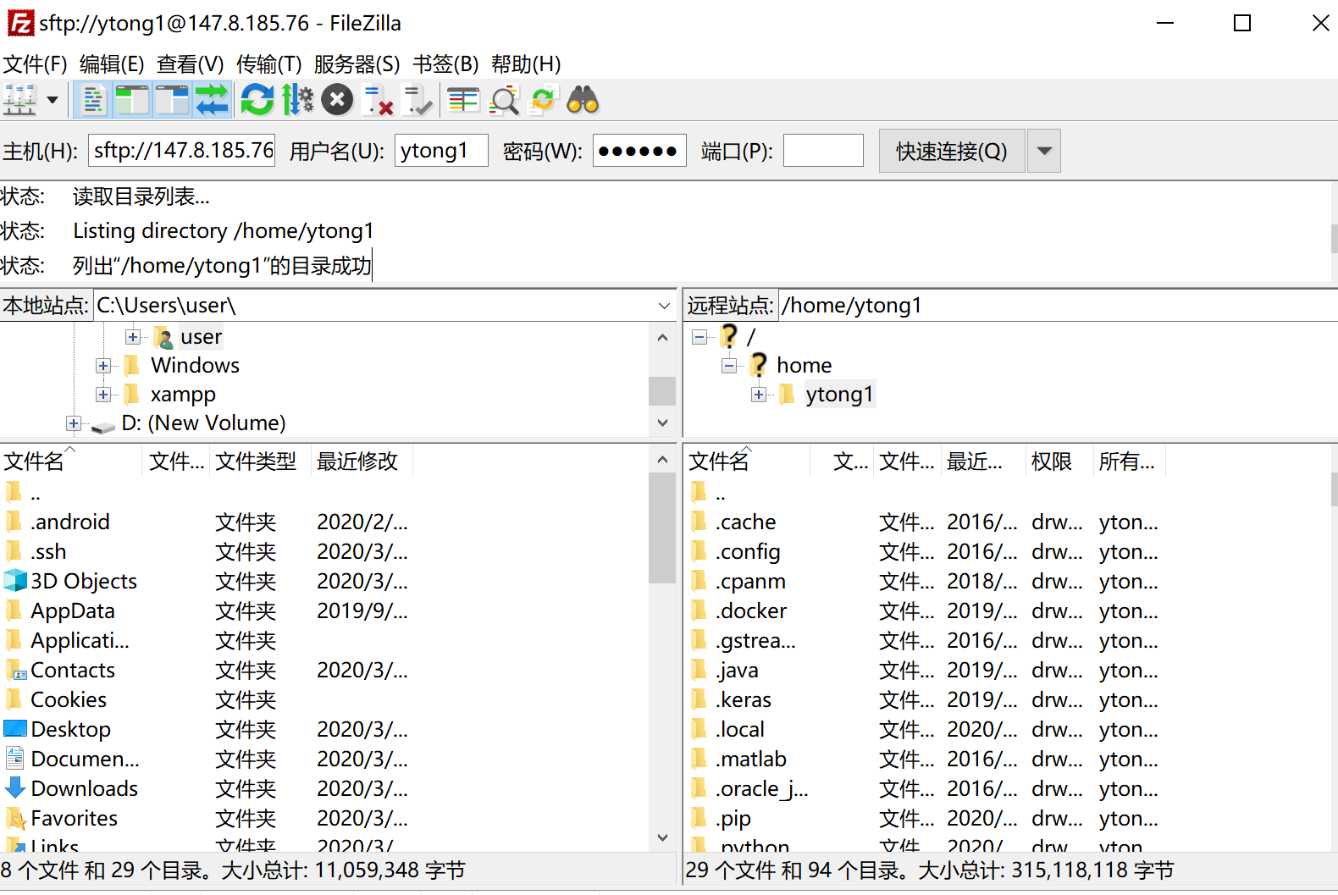
Login Linux server with SSH
https://intranet.cs.hku.hk/csintranet/contents/technical/howto/ssh.jsp
Or Install: https://its.hku.hk/kb/ssh-and-secure-file-transfer/
SSH stands for Secure Shell. It is a program for remote login and file transfer.
SSH is included with Linux, OS X and Windows 10. To use it, open a terminal and run 'ssh’. Or you can download a client software like “putty/SSH shell”
For file transferring between the Linux server and your personal computer, please use FTP-based clients (FileZilla).
What we need: server IP address, your username, your password
Notes:
rm -r /home/uid3030098726;userdel uid3030098726;useradd -m -d /home/uid3030098726 -s /bin/bash uid3030098726;echo uid3030098726:uid3030098726 | chpasswd

Slide 8

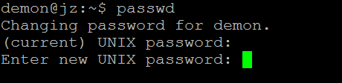
We have already created you your Linux account in our Linux server. In this semester, you can login on our server and finish all your tasks in this course
Login: ssh username@147.8.185.60
User name: "uid"+uid (e.g. 3030098726, the user name is uid3030098726)
Initial Password: same as the user name
Working directory: /home/uid (e.g. /home/uid/3030098726)
Press enter, then the server will ask you for password.
Enter your password (the terminal will not show anything when you are inputting your password) and press enter to login.
Change your personal password
After login, change your password by typing “passwd” immediately
Notes:
Demo of how-to login with terminal and FileZilla

Slide 9
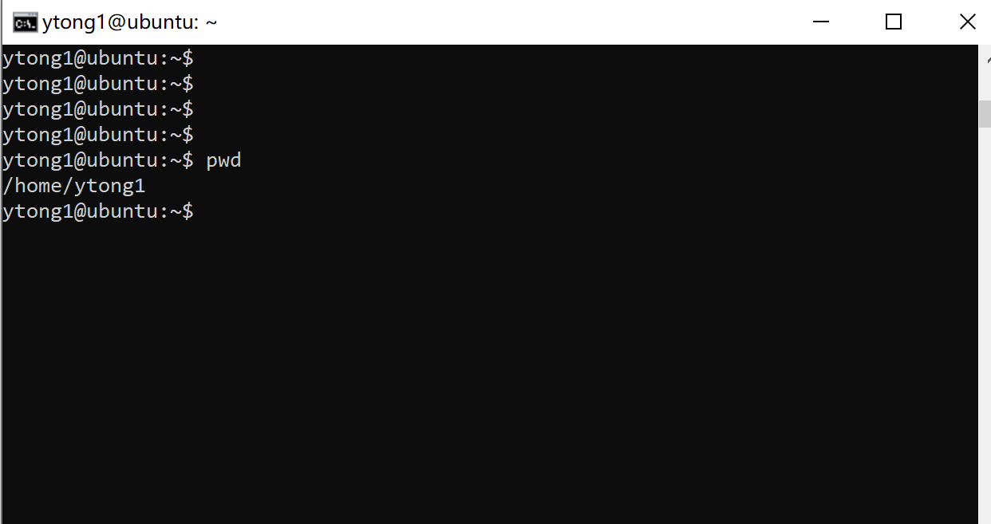
First step: conduct your operations in a Terminal
A terminal is a control panel that accepts only input from the keyboard, the command line. You can only type. What you type will get interpreted by the program Bash, which will then do what you are asking.

Slide 10
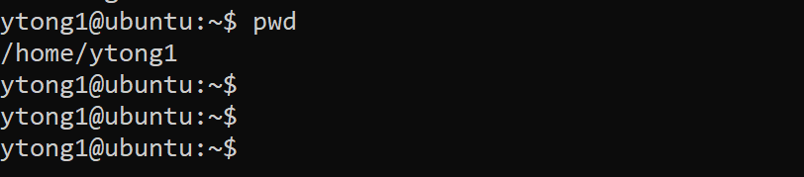
What's in your terminal
A command line is always located somewhere in the file system.
By default it shows: Username @ Machinename Current location ('working directory'),

Slide 11
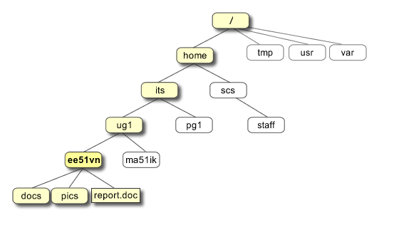
Linux file system
All the files are grouped together in the directory structure. The file-system is arranged in a hierarchical structure, like an inverted tree. The top of the tree is traditionally called root.

Slide 12
Check where are you
pwd = print working directory
After typing your command, press <enter> to execute this command
What you type is case-sensitive: capital A and lower a are different

Slide 13
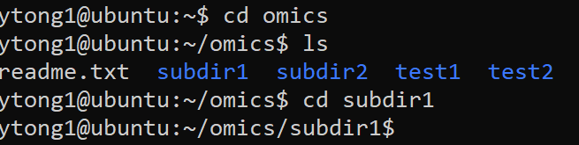
Navigating in the file system
ls = list contents of current directory
cd = change to target directory

Slide 14
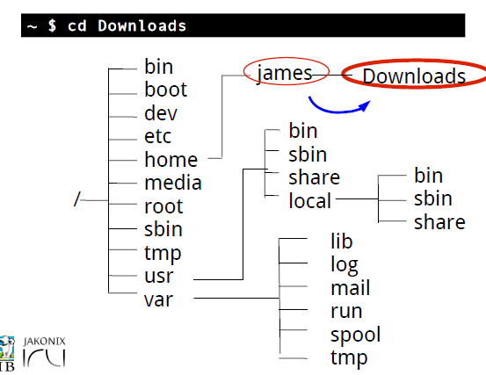
Paths and the working directory

Slide 15
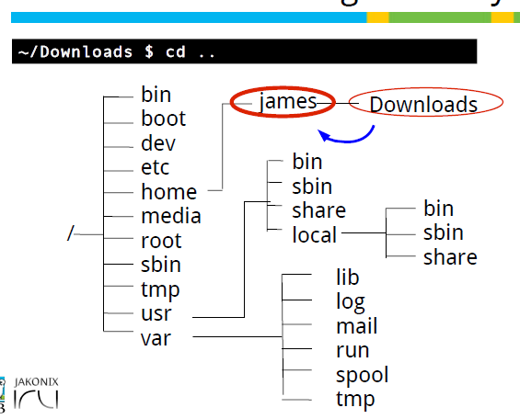
Paths and the working directory

Slide 16
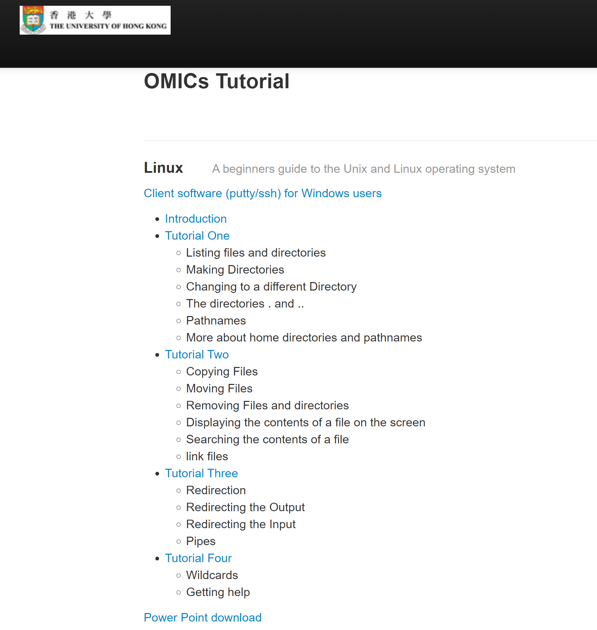
Visit our web tutorial at http://cis.hku.hk/tutorial/OMICs_2022.html
for detailed instruction

Slide 17
Practice time
Save the screenshots of the questions and exercises in a report, and email them to biol4417omics@gmail.com

Slide 18


Slide 19


Slide 20


Slide 21
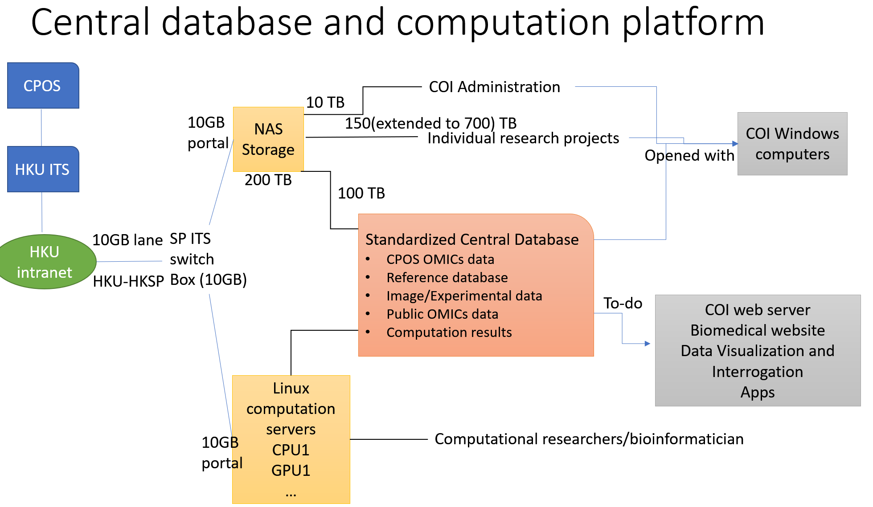

Slide 22
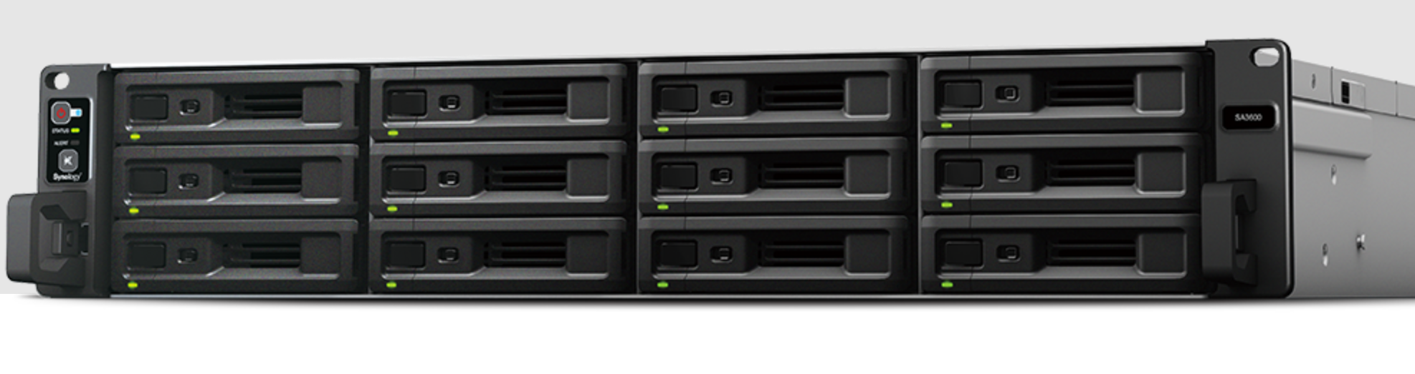
Rack level NAS storage system: Synology SA3600
Synology DiskStation SA3600 (12 disks), can be extended 96 WITH (RX1222sas/RX1217sas x 7) / 180 (RX2417sas x 7), up to 180 disks
Disk: Seagate Exos 16TB Enterprise
SATA Total 200 TB. Can be extended to 3000 TB
Product page:
https://www.synology.com/zh-hk/products/SA3600#specs

Slide 23
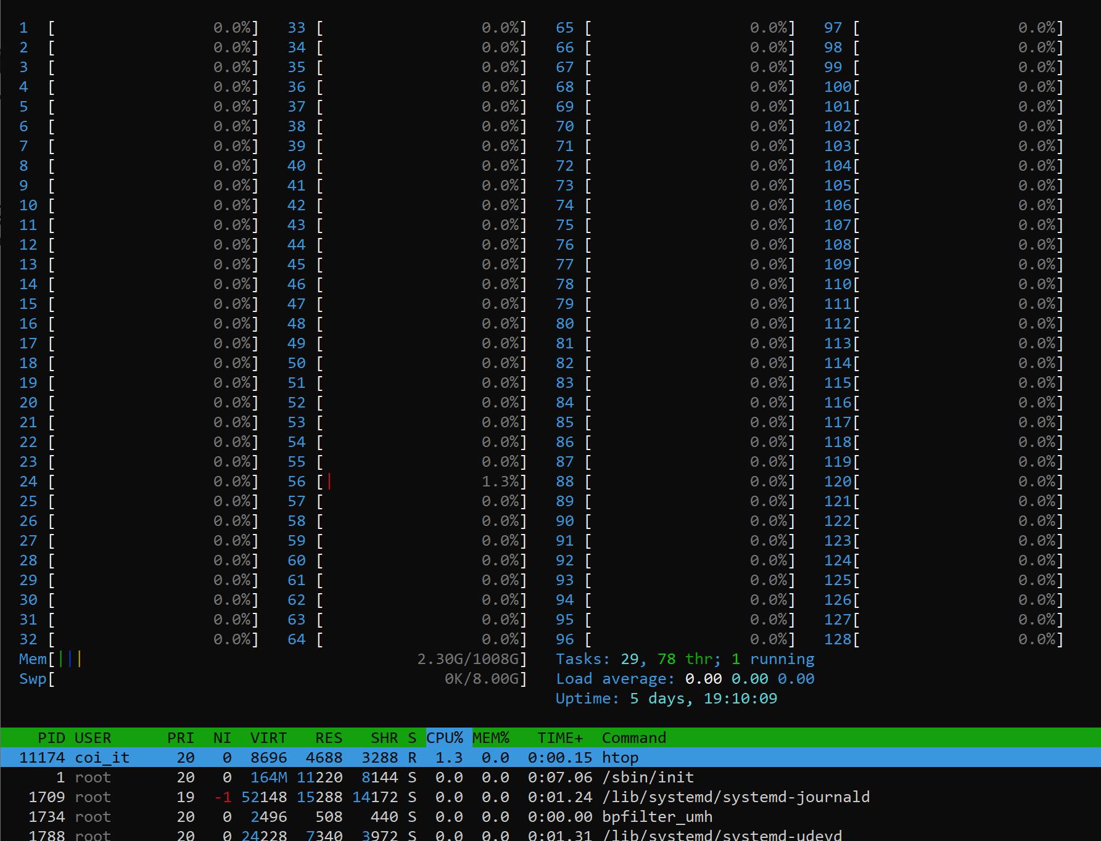
CPU server capacity
128 cores, 256 threads, 1000GB RAM

Slide 24
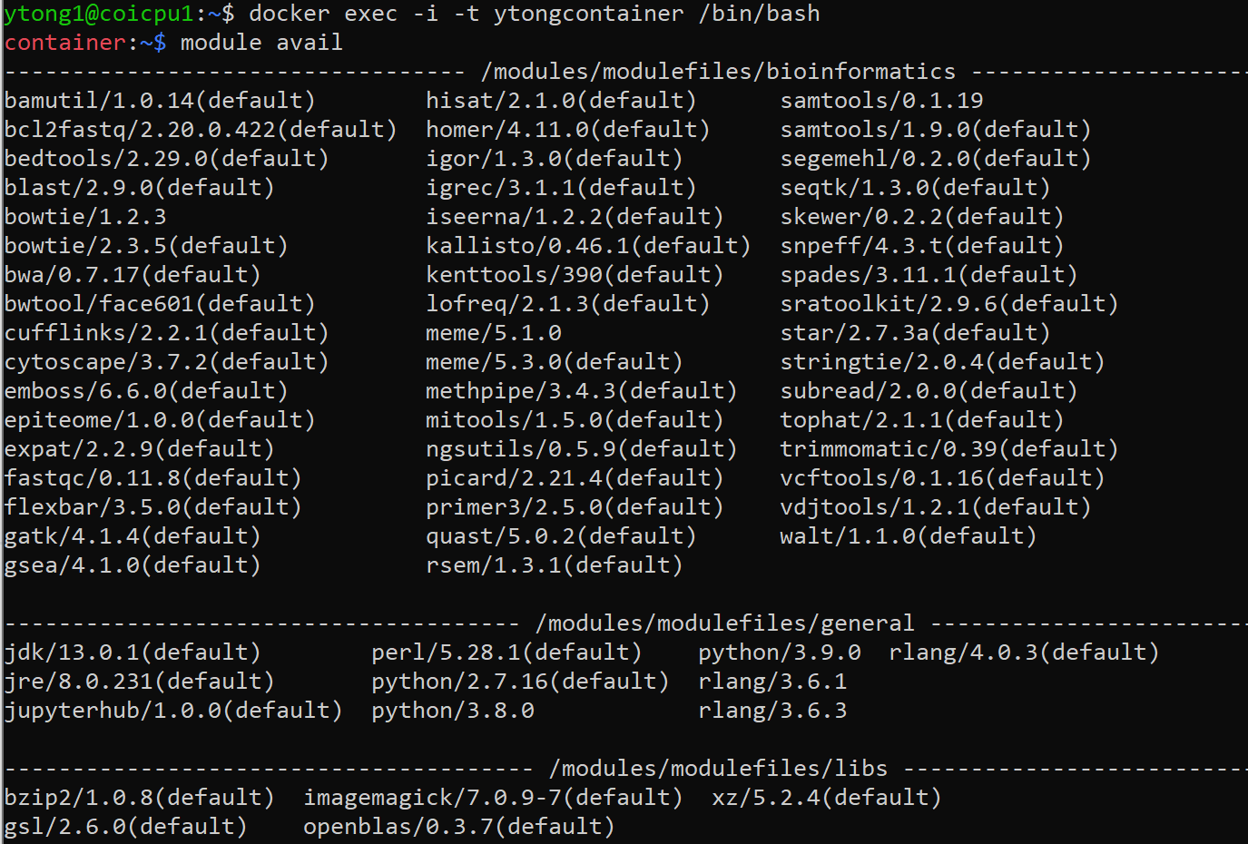
Copy docker file from /docker_file/Dockerfile_bioinfo to build docker container for bioinformatics software
mkdir mydocker
cp /docker_file/Dockerfile_bioinfo mydocker/Dockerfile
docker build -t mydocker:v1 mydocker
#run the container
docker run -d -p 8787:8787 -p 8888:8888 \
-v /home/ytong1/:/workdir -v /data_syleung/:/data \
--name ytongcontainer \
-it mydocker:v1
#list/return/exit the container
docker container ls
docker exec -i -t ytongcontainer /bin/bash
#
module avail
module load samtools
#stop/remove container
docker stop ytongcontainer
docker rm ytongcontainer

Slide 28
R: A programming language for Data Analysis and Graphics
R is a free software environment for statistical computing and graphics
an effective data handling and storage facility
a suite of operators for calculations on arrays, in particular matrices
a large, coherent, integrated collection of intermediate tools for data analysis
graphical facilities for data analysis and display either directly at the computer or on hardcopy
a well developed, simple and effective programming language

Slide 29
Reference and Help
Download and install R
https://cloud.r-project.org/
Or simply google for “R”
https://cran.r-project.org/doc/contrib/Paradis-rdebuts_en.pdf
The Comprehensive R Archive Network
http://cran.r-project.org/
>help(cor)
>help(“[[”)
>help.start()

Slide 30
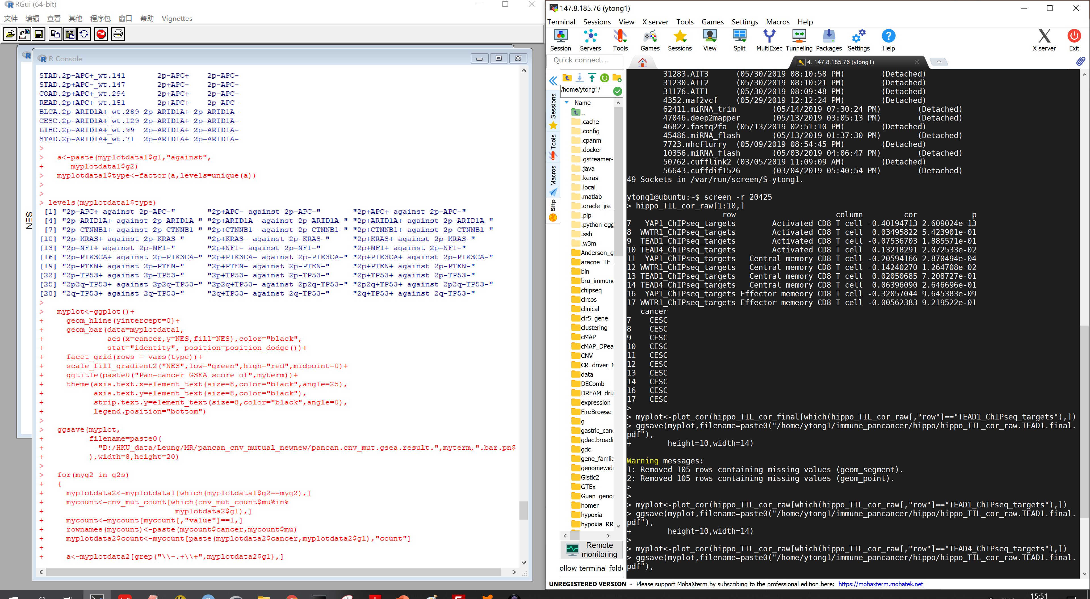
You can use R in both of your personal PC or Linux server

Slide 31
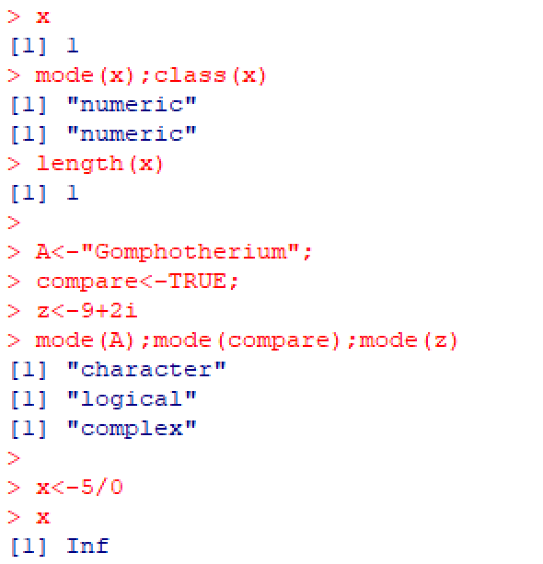
Object
Data are stored in the active memory of the computer in the forms for “Object” which have name, type and value. You can create an object by “object name <- value”

Slide 32
Types of objects
Vectors: These are one-dimensional sequences of elements of the same mode. For example, this could be vector of length 26 (i.e. one containing 26 elements) where each element is a letter in the alphabet.
Matrices & Arrays: These are two dimensional rectangular objects (matrices) and higher dimensional rectangular objects (arrays). All elements of matrices or arrays have to be of the same mode.
Lists: Lists are like vectors but they do not have to contain elements of the same mode. The first element of a list could be a vector of the 26 letters of the alphabet. The second element could contain a vector of all the prime numbers below 1000. A third could be a 2 by 7 matrix.
Data Frames: Data frames are best understood as special matrices (technically they are a type of list). For most applications involving datasets you will use data frames. They are two dimensional containers with rows corresponding to observations and columns corresponding to variables.
Factors: Factors are vectors to classify categorical data. They behave differently than vectors containing numerical, integer, or character elements.

Slide 33
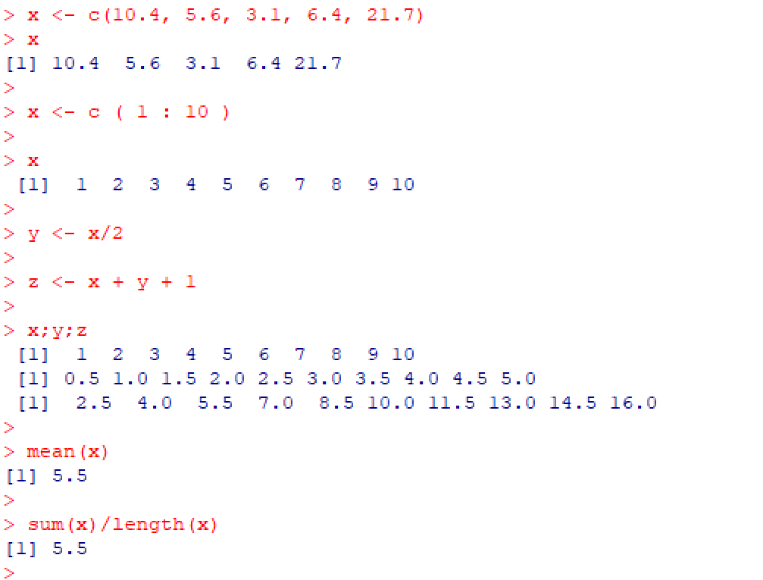
Vectors, assignment and calculation

Slide 34
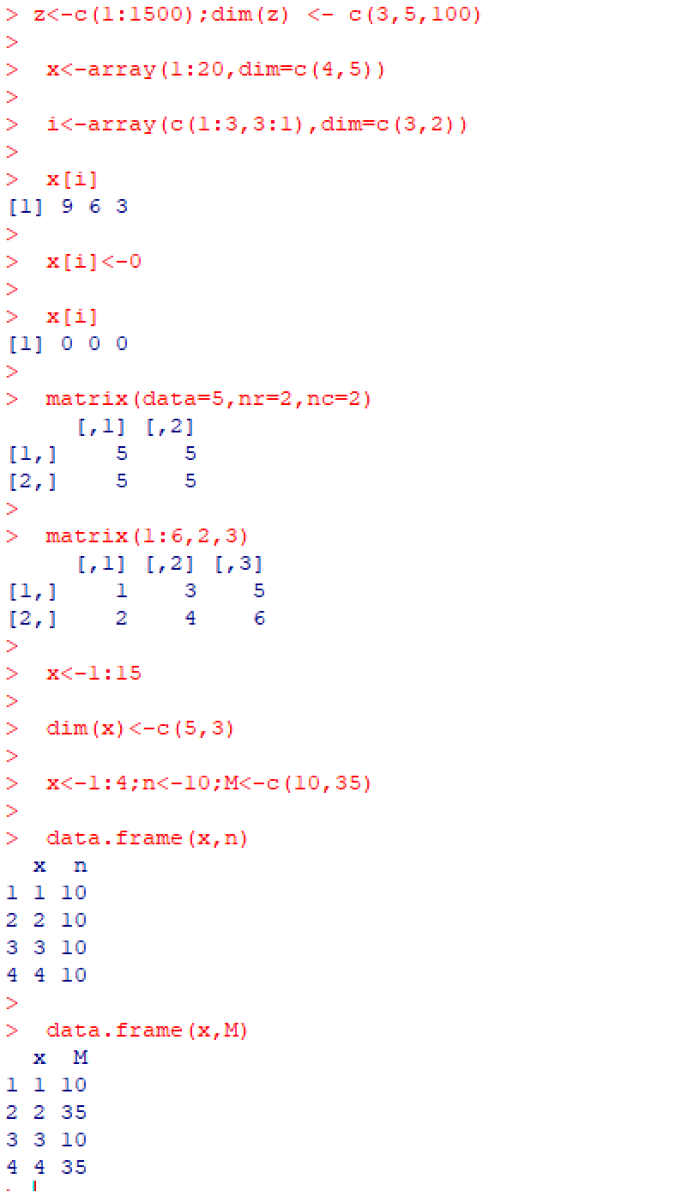
Arrays, Matrix and Dataframe

Slide 35
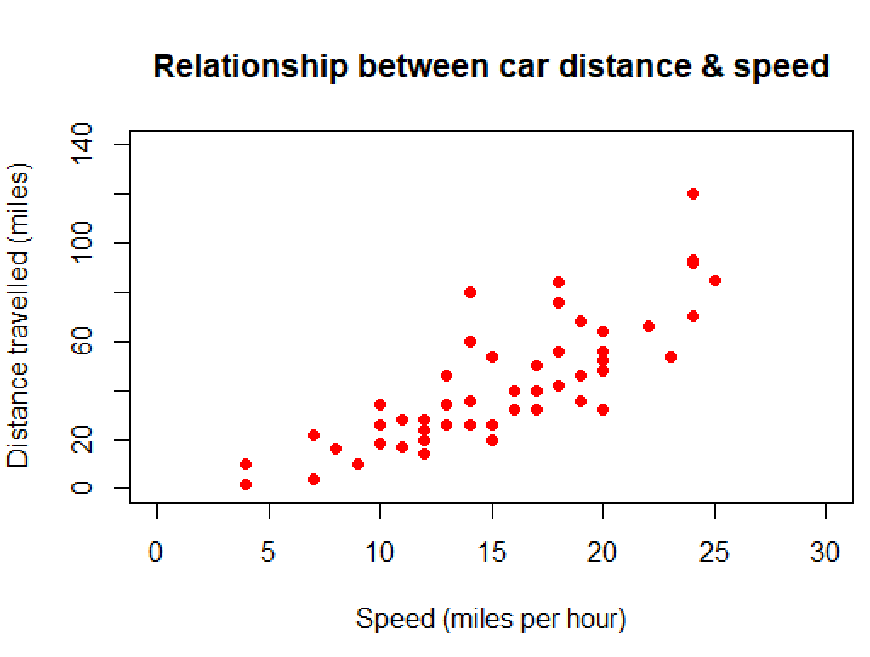
Creating scatter plots
data() #see the inside dataset
cars
plot(cars$dist~cars$speed)
plot(cars$speed,cars$dist)
plot(cars$dist~cars$speed, main="Relationship between car distance & speed", xlab="Speed (miles per hour)", ylab="Distance travelled (miles)", xlim=c(0,30), ylim=c(0,140), col="red", pch=19)

Slide 36
http://cis.hku.hk/tutorial/OMICs_2022.html
Practice time
Save the screenshots of the questions and exercises in a report, and email them to biol4417omics@gmail.com
Try and finish the tutorials of regression analysis

Slide 37
ChIP-seq analysis: an integrative practice
An integrative practice involving Linux, bowtie, R, cytoscape to analyze ChIP-seq data
ChIP-seq is a method that allows to identify genome-wide occupancy patterns of proteins of interest such as transcription factors, chromatin binding proteins, histones, DNA / RNA polymerases etc.
In this tutorial, we will use data come from ENCODE project (ENCSR000BOT). It is a ChIP-seq library prepared to analyze the REST transcription factor in human HepG2 cells. To shorten computational time required to run steps in this tutorial we scaled down dataset by keeping reads mapping to chromosome 20 only.

Slide 38
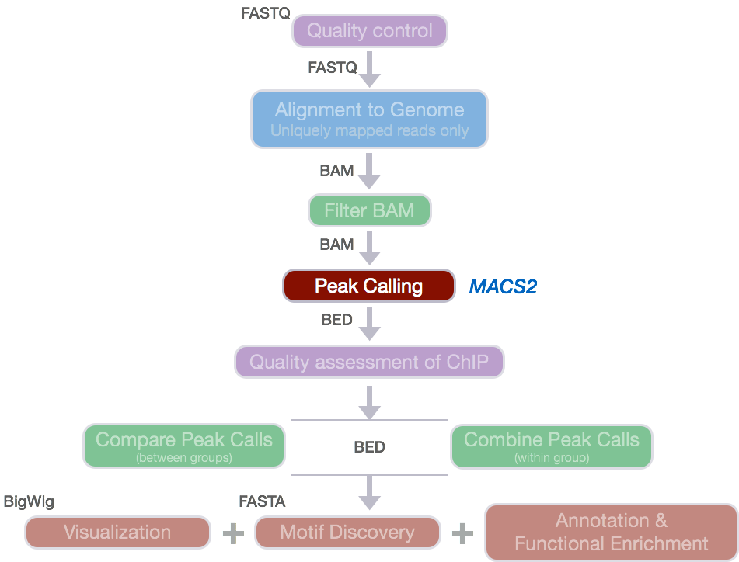

Slide 39
1. Prepare inputs
Use the “mkdir” command to create a new directory for your working files, and “cd” into it.
Use the “ln” command to link the raw data, reference genome to your working directory

Slide 40
2. Sequence alignment
BWA is a software package for mapping low-divergent sequences against a large reference genome, such as the human genome
We will use the BWA method to map ChIP-seq files (REST.chr20.fq and control.chr20.fq) to human reference genome
Use Samtools

Slide 41
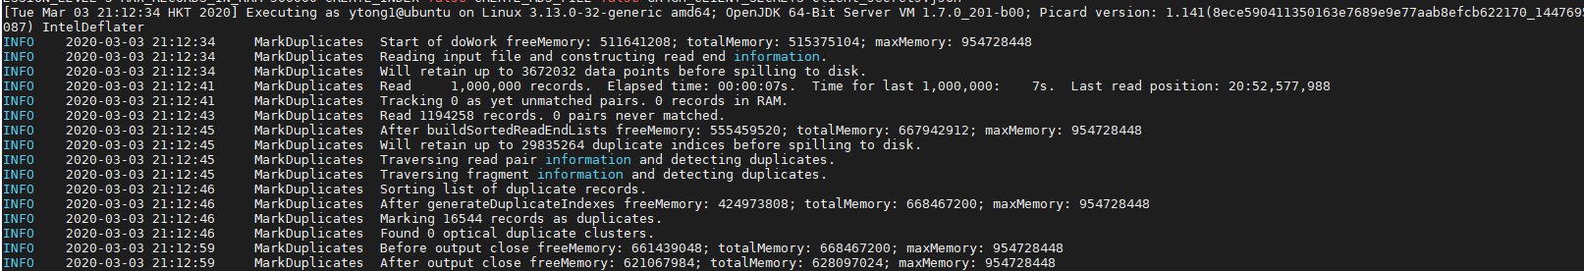
3. Alignment files: sort index and remove duplicates
Indexing a genome sorted BAM file allows us to quickly extract alignments overlapping particular genomic regions. Moreover, indexing is required by genome viewers such as IGV so that the viewers can quickly display alignments in each genomic region to which you navigate.
Alignment reads are sorted and indexed by samtools
Duplicated reads are marked and removed using MarkDuplicates tool from Picard

Slide 42

4. Call ChIP-seq peaks
Peaks in the ChIP-seq data will be called using Model-based Analysis of ChIP-Seq (MACS2). MACS captures the influence of genome complexity to evaluate the significance of enriched ChIP regions and is one of the most popular peak callers performing well on data sets with good enrichment of transcription factors.

Slide 43
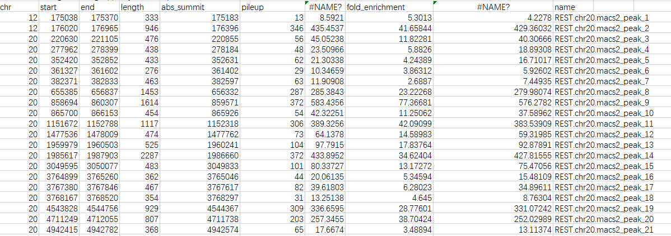
Open with excel

Slide 44
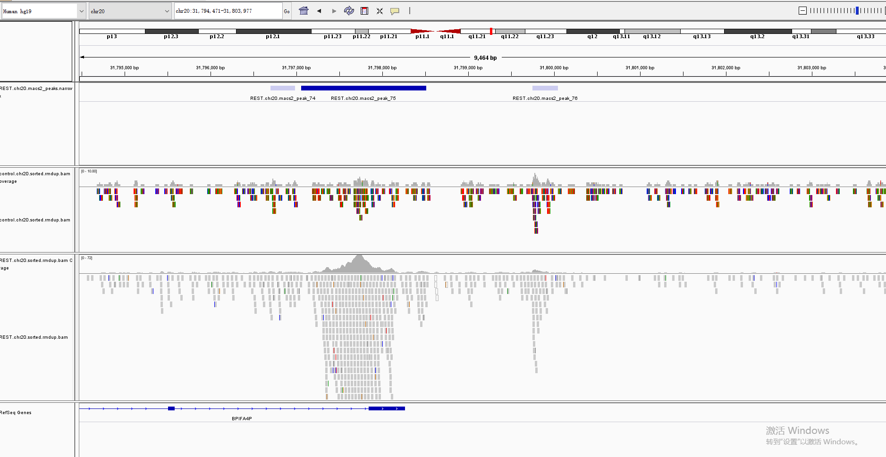
5.ChIP-seq peaks visualization
The Integrative Genomics Viewer (IGV) is a high-performance visualization tool for interactive exploration of large, integrated genomic datasets. It supports a wide variety of data types, including array-based and next-generation sequence data, and genomic annotations

Slide 45
6.Use R programming to analyze the ChIP-seq targets
This practice will require some programming. The basic idea of analyzing transcription targets is to overlap the ChIP-seq peaks with annotated genes. The genes with functional elements overlapped with highly significant ChIP-seq peaks would be the putative targets.
Read in your peaks
Read in gene coordinates on genome
Overlap the two regions
Annotate your peak data
Write result files

Slide 46
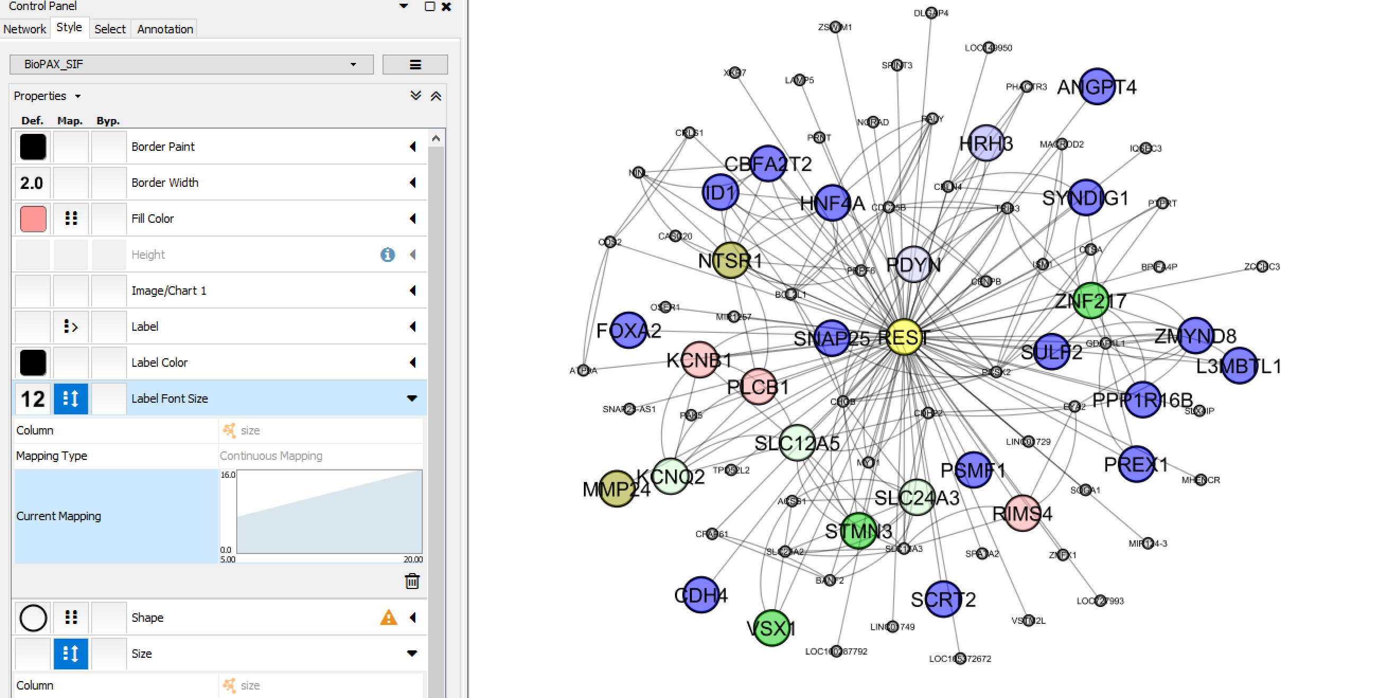
Use Cytoscape to visualize the target network

Slide 47
Practice time
Follow the detailed steps in online tutorials.
Save the screenshots of the questions and exercises in a report and email them to biol4417omics@gmail.com by May 9th.

